Slide 1
🏢
Dwell Core
Smart Apartment Management System
Submitted By
B. Hamsika
AI-Assisted Full-Stack Web Development · 2026

Slide 2
02 Introduction
🏢
👑
🏠
About the Project
Admin Role
Resident Role
Dwell Core is a full-stack web application built to digitize and streamline apartment community management. It replaces manual paperwork with an intelligent, role-based digital platform accessible from any browser.
Developed using Node.js, Express, MongoDB, and EJS, the system provides separate portals for Administrators and Residents — each with tailored dashboards, features, and access controls.
Full system control
Personal portal access
📊
🔔
Live Dashboard
Notifications
Charts & analytics
Real-time alerts

Slide 3
03 Objectives
01
🔐 Secure Authentication
02
📊 Analytics Dashboard
Role-based login with bcryptjs hashing and persistent sessions via connect-mongo.
Real-time statistics and Chart.js visualizations for revenue, complaints, and bills.
03
🛠️ Complaint Management
04
💰 Bill & Payment System
Residents raise complaints with priorities; admins update status and add resolution notes.
Auto-calculated bills with Maintenance, Water & Power; full payment history with transaction IDs.
05
📢 Notice Board
06
🔍 Search & Filter
Admins broadcast notices; residents receive real-time in-app notifications.
Filter residents by flat, complaints by status/priority, and bills by month or payment status.

Slide 4
04 Stakeholders
👑 Admin / Manager
🏠 Resident
💻 Developer / System Admin
Society manager, building secretary, or property management staff.
Flat owners or tenants living in the apartment complex.
Technical team maintaining the system and MongoDB infrastructure.
Key Capabilities
Key Capabilities
Key Capabilities
Register & manage residents
Generate and track bills
Resolve or delete complaints
Post notices to all residents
View revenue analytics & charts
Access payment records
View personal dashboard
Raise and track complaints
Pay pending bills online
View payment history
Read notice board
Manage personal profile
Manage server & database
Run seed scripts for demo data
Configure .env settings
Deploy to production
Add new features & modules
Monitor error logs

Slide 5
05 Programming Languages, Tools & Software
⚙️ Backend
🗄️ Database
Node.js
Express.js
bcryptjs
express-session
connect- mongo ·
method-override
MongoDB
Mongoose ODM
connect-mongo
MongoDB Compass
Local / Atlas
🎨 Frontend
🛠️ Tools / Env
EJS Templates ·
Custom CSS3 ·
Chart.js ·
Font Awesome 6 ·
Responsive Grid
VS Code
nodemon
dotenv
Git & GitHub
Postman
npm

Slide 6
06 Prompts Used — Part 1 (P1–P3)
💬 AI Prompts Used to Generate the Code
P1
Build a full-stack web application named "Dwell Core – Smart Apartment Management System" using Node.js (Express) and MongoDB. The system must support Admin and Resident roles with authentication, role-based access, and CRUD operations.
P2
The UI should be colorful, responsive, and include background images for every page (dashboard, complaints, bills, notices).
P3
Implement secure user authentication using email and password. Use bcryptjs for password hashing and express-session with connect-mongo for session storage. Allow users to register and login with roles (admin or resident). Maintain sessions and restrict unauthorized access. Include logout functionality.

Slide 7
06 Prompts Used — Part 2 (P4–P6)
💬 AI Prompts Used to Generate the Code
P4
Create a role-based access system with Admin and Resident roles. Admin should have full control over residents, complaints, bills, and notices. Residents should only access personal dashboard, raise complaints, view notices, and pay bills. Protect routes using middleware.
P5
Implement a payment system that stores payment details including user ID, amount, and timestamp. Allow residents to pay bills and view payment history. Update bill status after payment.
P6
Create a notice board where admin can add notices and residents can view them. Each notice should include text and timestamp. Display notices in a clean list format.

Slide 8
06 Prompts Used — Part 3 (P7–P9)
💬 AI Prompts Used to Generate the Code
P7
Add search and filter functionality for bills, complaints, and residents. Allow searching by flat number and filtering by status or priority.
P8
Create an analytics dashboard using Chart.js to display revenue, complaint status, and bill payment statistics. Include bar charts and pie charts.
P9
Implement a notification system to alert residents when: a complaint is resolved, a new bill is generated, or a payment is successful. Store notifications with timestamps and show them in a Notifications page.

Slide 9
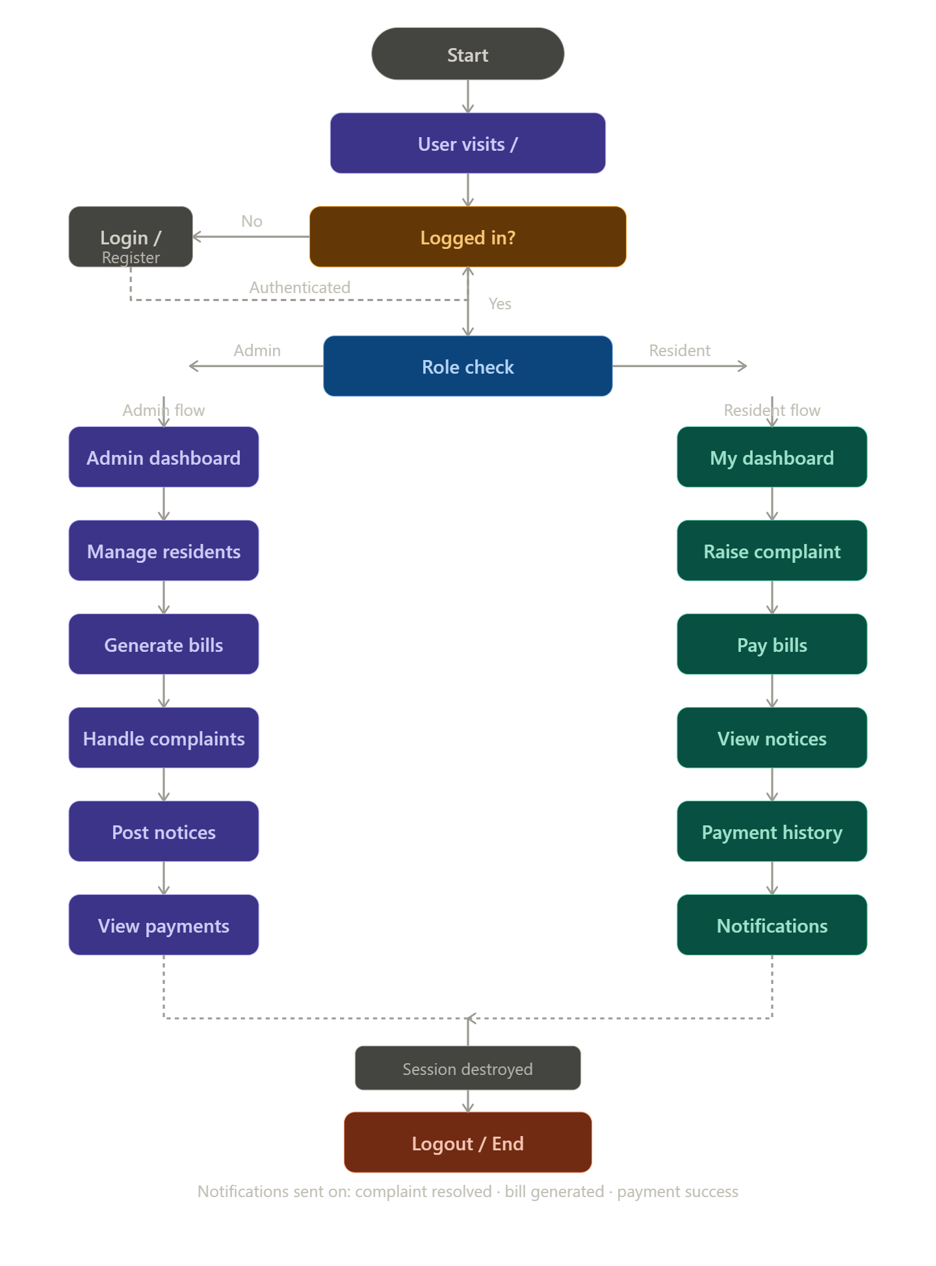
07 Workflow Flowchart

Slide 10
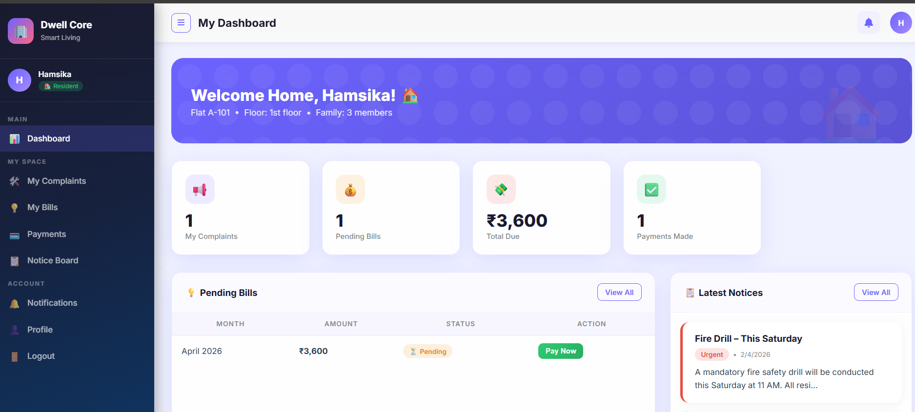
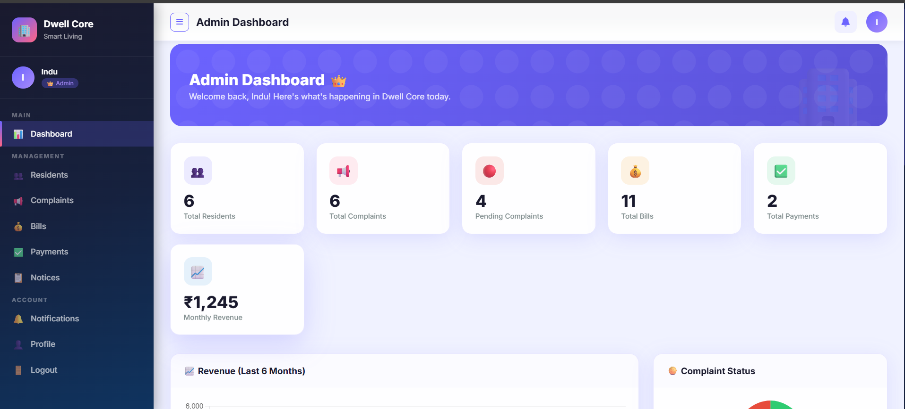
08 Frontend Views — Application Screenshots
🏠 Resident Dashboard — My Dashboard View
👑 Admin Dashboard — Analytics & Stats View
Built with Node.js · Express · MongoDB · EJS · Chart.js

Slide 11
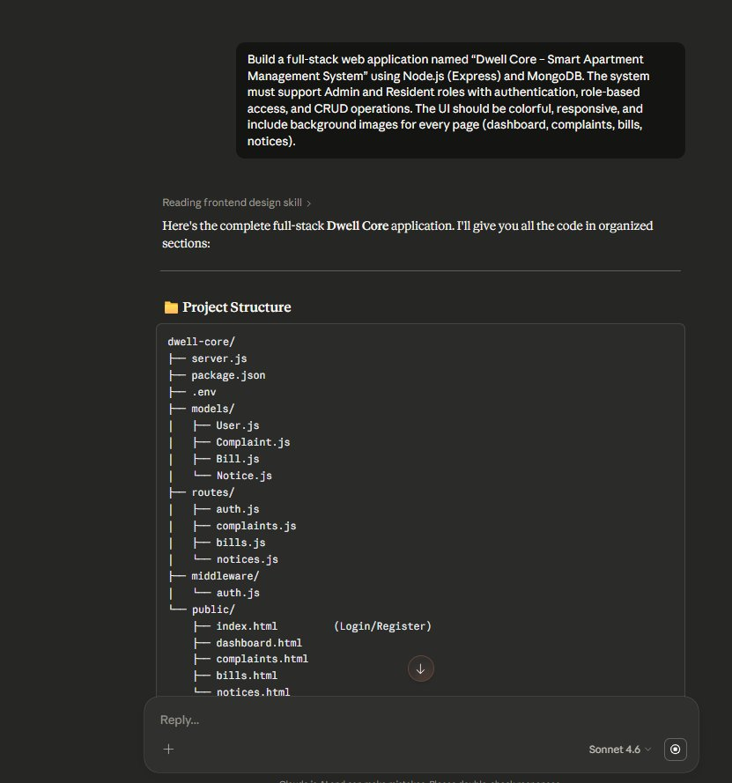
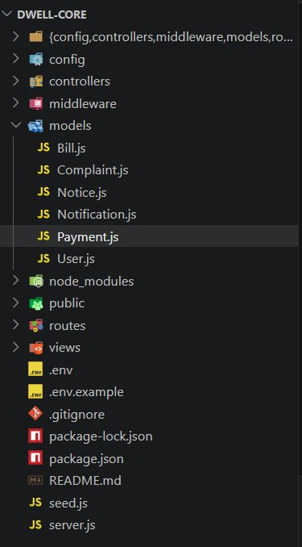
09 Proof of Prompts Generating Code
📸 Claude generating project structure code from prompt
📸 VS Code — Generated project file structure

Slide 12
10 References
01
🟢 Node.js Official Documentation
02
⚡ Express.js Framework Guide
https://nodejs.org/en/docs
https://expressjs.com/en/guide/routing.html
03
🍃 MongoDB Documentation
04
📦 Mongoose ODM Documentation
https://www.mongodb.com/docs/
https://mongoosejs.com/docs/guide.html
05
📊 Chart.js Documentation
06
🔐 bcryptjs – npm Package
https://www.chartjs.org/docs/latest/
https://www.npmjs.com/package/bcryptjs
07
📝 EJS Embedded JavaScript Templates
08
🤖 Anthropic Claude AI (Code Generation)
https://ejs.co/#docs
https://claude.ai

Slide 13
Thank You!
Dwell Core — Smart Apartment Management System
Presented by B. Hamsika
AI-Assisted Full-Stack Web Development · 2026

